Slide 1
Agent based models of debt and collapse

Slide 2
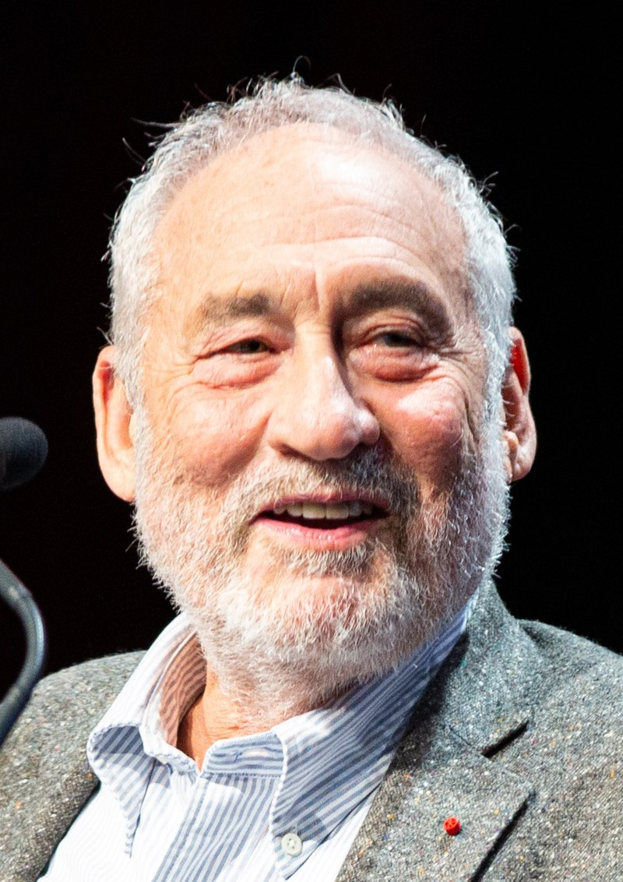
Why econophysics?
Or: Are physicist the most arrogant scientists?
What does the economists say?
“What we seek from a ‘benchmark model’ in macroeconomics is not always clear. [He] suggests that we should be looking ‘for a simple model which we could teach to graduate students to provide them with a less misleading framework […]”
“The models should capture what we believe are the macro-essential characteristics of the behavior of firms and people, and not try to capture all relevant dynamics. Only then can they serve their purpose, remain simple enough, and provide a platform for theoretical discussions.”
“And with so many parameters, macro-econometrics becomes little more than an exercise in curve fitting […]”
All quotes and equation from [Stiglitz18].
Photo by Jérémy Barande
Notes:
Don’t read all the quotes out, just mention things like:

Slide 3
Fisher’s debt-deflation cycle
Original. Simplified. My interpretation/implementation.

Slide 4
Introduction to model
Variables: Production, debt (and money), beta
Transaction, buyer j(asmine) and seller i(saac)

Slide 5
Algorithm
Simplified i.e. “update free interest rate, adjust interest rate for PD” etc
Variable reminder
p: production capacity
d: debt
β: risk factor
α: d to p efficiency
r: interest rate

Slide 6
Parts of algorithm
Updating Interest rate free, buying power
Updating interest rate adjusted
Bank colleague: “Ehm, shouldn’t we take into account they may not pay back the loan?”
Adjusted interest rate outline of derivation, plot of values

Slide 7
Results
mean and interest rate
beta
Animation values

Slide 8
Difficulties
Too extreme boom-busts
Companies hate debt (beta small)
Greedy bank

Slide 9
References
[Stiglitz18] Stiglitz, J. E. (2018). Where modern macroeconomics went wrong. Oxford Review of Economic Policy, 34(1-2), 70-106.

